Slide 1
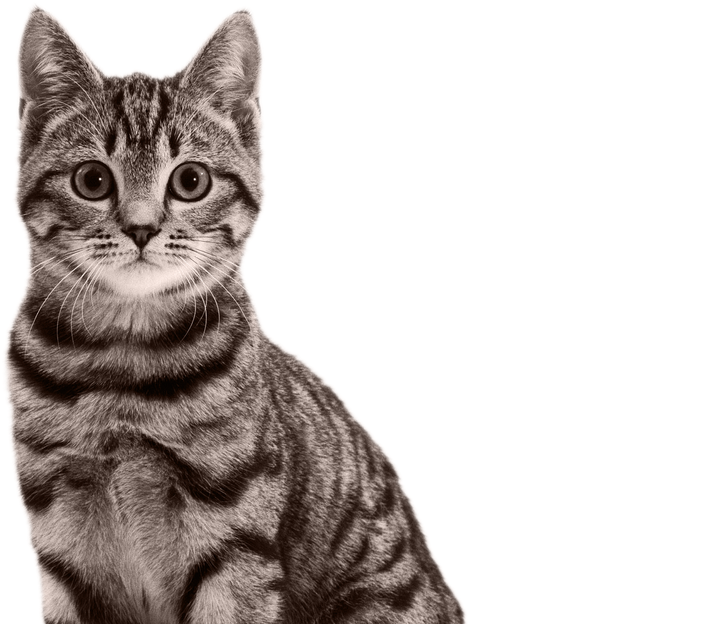


Cats acoustic data Project
Bony Audrey
de Croutte Anne-Victoire
February 5th, 2021
Supervisors : Amandine Schmutz (Mars)
François Husson (Agrocampus Ouest)

Slide 2


Company
MARS : worldwide company with 4 segments :
Petcare (Royal Canin, Whiskas…)
Mars Wigley (m&m’s, mars, celebrations…)
Food (Ben’s Original, Suzi Wan…)
Edge (research on human health about nutrition)
WALTHAM Petcare Science Institute is Mars Petcare's pet research and development center, whose purpose is to make A BETTER WORLD FOR PETS
Research on pet nutrition

Slide 3
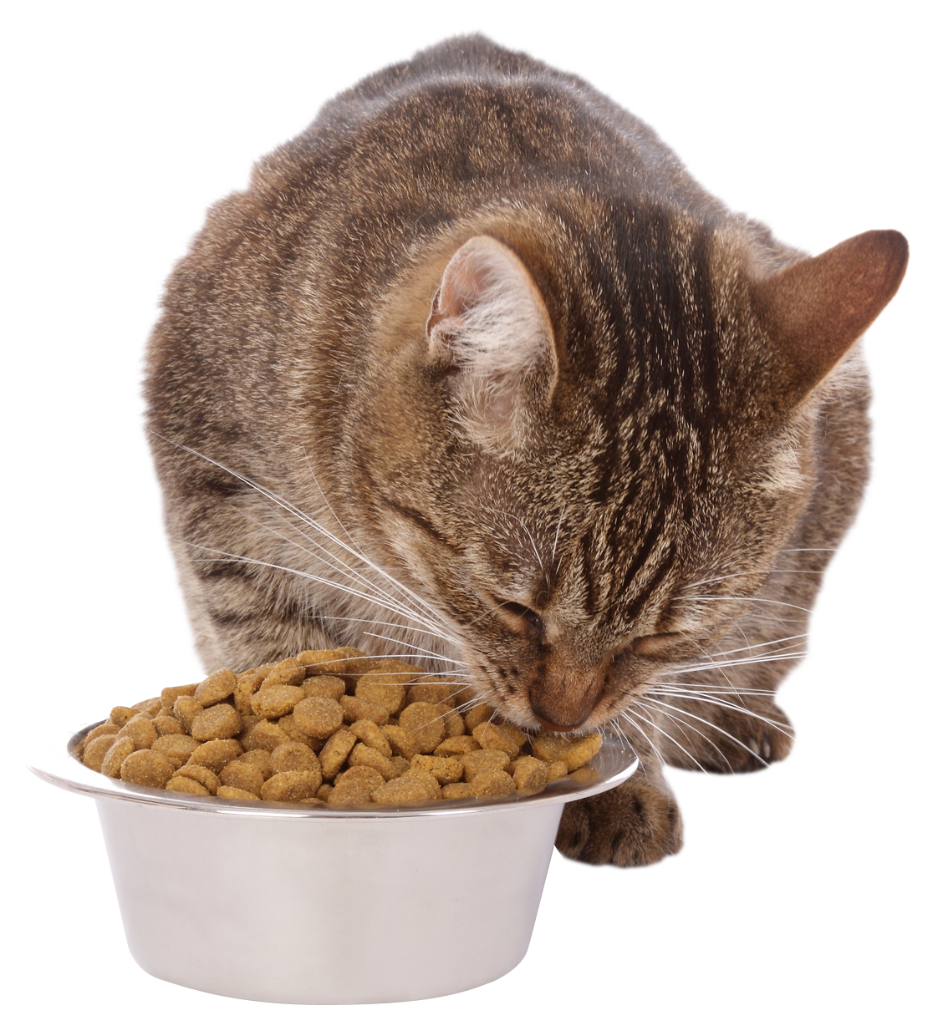
Context
Automation of data acquisition
Task to be digitised: Counting of breaks and bites when cats eat kibbles from video recordings.
Test of an acquisition protocol for event
detection
Notes:
Image : https://www.pinterest.fr/pin/568931365426236282/ (Verlina)

Slide 4
Issues
Does the data acquisition method allow enough data quality for event counting ?
Does audio data allow the detection of this kind of events?

Slide 5
Overview
I – Usability of Mars data
II – Event counting from audio recordings

Slide 6
I. Usability of Mars data
A. Data presentation
A cat eats a kibble
Experiment info's
Recording
Responses
Cat name
Diet
Kibble
Session
Amplitude values
25 seconds x 44,1kHz
=
1.1 million variables
Number of breaks
Number of bites

Slide 7
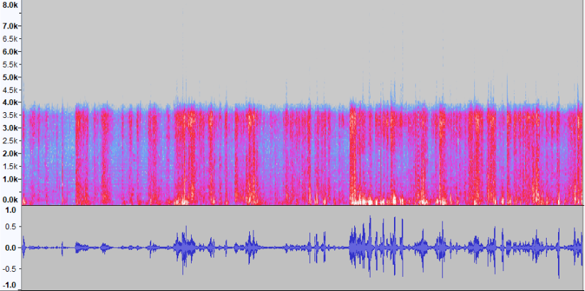

I. B. Visualisation
Record 32
1 break
23 bites
Spectrogram STFT
Oscillogram
(Amplitude curve)

Slide 8
I. C. Processing
METHOD
Reducing noise
Filtering frequencies
Does not allow automation
Predicting with a weak label *
Does not work on noisy data
Functional data Analysis
* weak label : here labels synthesise an information about breaks and bites events but does not characterise them precisely

Slide 9
II. Counting events A. Creation of a new data set
PROTOCOL
Take a video (with a phone) of the cat while it’s eating a kibble around 30 cm far from the head
7 cats
3 types of kibbles
79 recordings
Less Noise
Video and audio
Non-standard duration
Varying collection conditions (distance, way of filming, recording gear, environment, etc.)

Slide 10
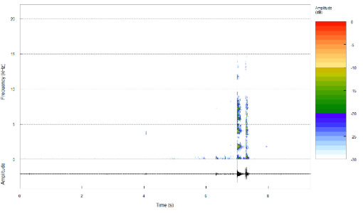
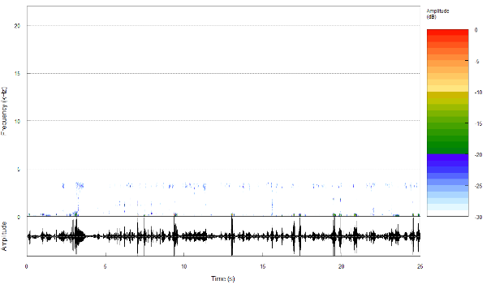
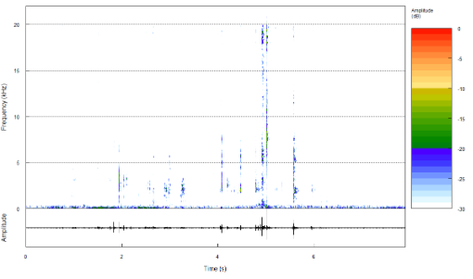
II. A. Creation of a new data set
Cathy, session 3, kibble A’
breaks
2 breaks observed
Cat1, session 9, kibble C
Moon, session 3, kibble A’
breaks
MARS DATA
NEW DATA

Slide 11

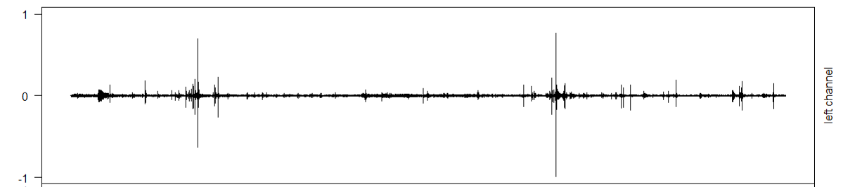
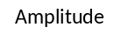

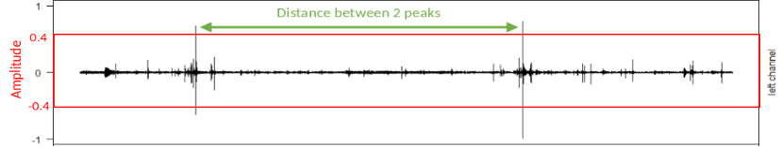
II. B. Amplitude - Method
Initial
Recordings
Normalised Recordings
Peak detection
Prediction
2 peaks

Slide 12
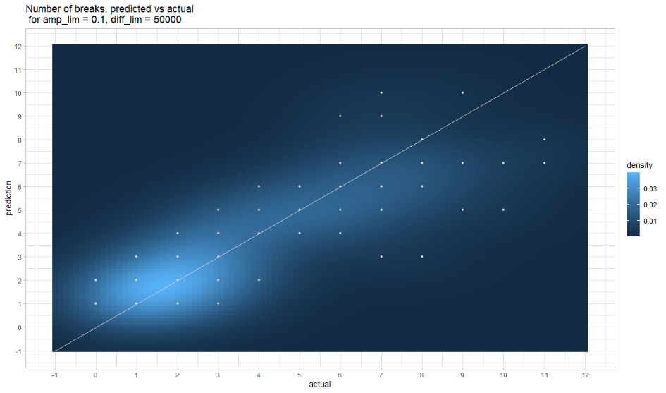
II. B. Amplitude - Results
MSE (Mean Square Error) = 2.52, the algorithm predicts the number of breaks with an accuracy of around 1.6 break

Slide 13


II. C. Machine Learning
Data Train
Initial
Recordings
2. Model Application
Machine Learning
Algorithm
Model from the Algorithm
1. Model Training
Probability profile of being a break
Finale Prediction

Slide 14
II. C. Machine Learning
Data Train
Initial
Recordings
2. Model Application
Machine Learning
Algorithm
Model from the Algorithm
1. Model Training
Probability profile of being a break
Finale Prediction

Slide 15
II. C. Machine Learning
Labelling
break
background noise
break
break
Collecting break and background noise
Break features data
Background Noise features Data
Supervised classification task Model
(Random Forest)
break
?
background noise

Slide 16
II. C. Machine Learning
Data Train
Initial
Recordings
2. Model Application
Machine Learning
Algorithm
Model from the Algorithm
1. Model Training
Probability profile of being a break
Finale Prediction

Slide 17

II. C. Machine Learning – Model application
Trim an initial recording into frames
Extract features from frames
Get the probability of being a break with the model
Probability to be a break

Slide 18
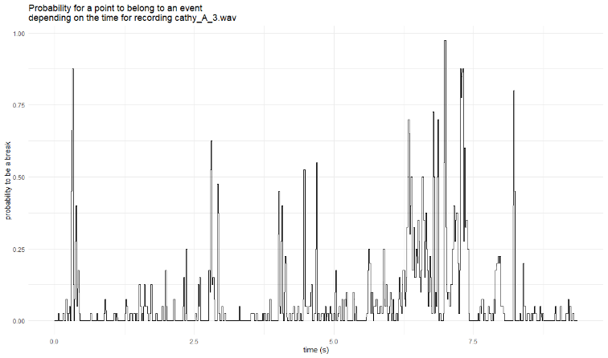
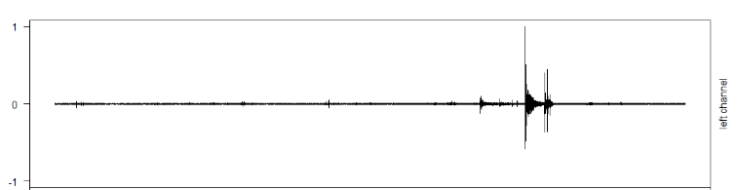
II. C. Machine Learning – Model application
Time Threshold
Probability Threshold
Probability of being a break throughout the recording vs amplitude of the recording -> not a clear correspondence

Slide 19
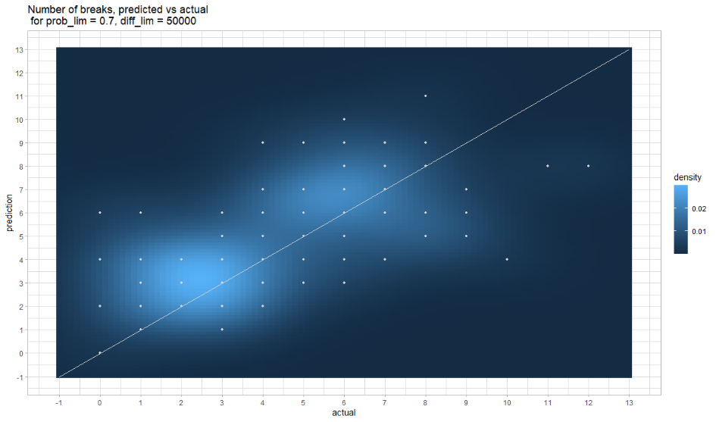
II. C. Machine Learning – Model application
MSE (Mean Square Error) = 5.01, the algorithm predicts the number of breaks with an accuracy of around 2.2 breaks

Slide 20
Improvements & Leads
Unavoidable background noises
Recordings
Frame with undetermined noise
Prediction
Amplitude selection
Machine Learning Model trained to differentiate noises from breaks
Note : Machine learning approach can differentiate bites and breaks
Independent Component Analysis

Slide 21
Conclusion
About Data acquisition method
Noise is a limiting factor for prediction. It must be kept to a minimum.
Strong labelling allows more technical possibilities that can be used for prediction.
About acoustic data for detection of events
Break produce a quite identifiable sound. Bites could be more difficult.

Slide 22
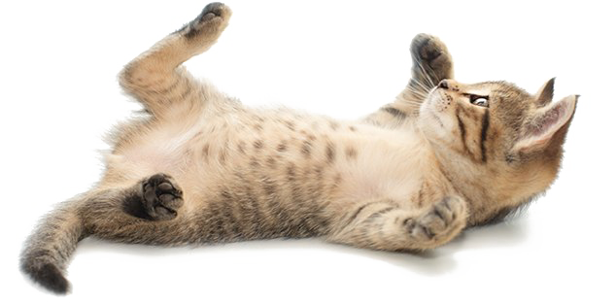
THANK YOU
Thanks to Amandine and François for their guidance and time.
Image sources : pngarts.com and Verlina

Slide 23
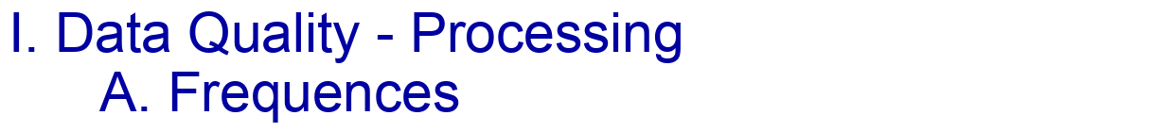
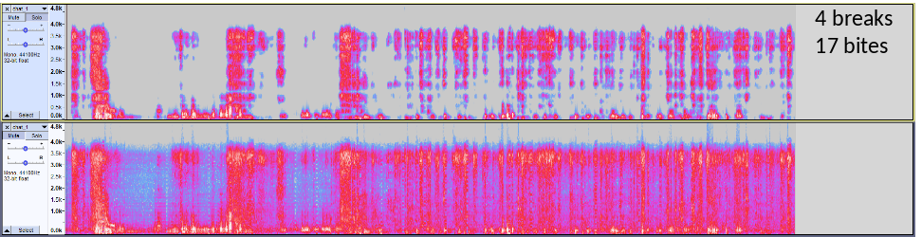


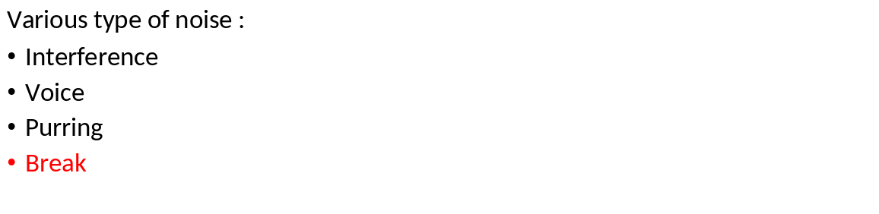

Slide 24
I. Data Quality – Processing B. ICA
Independent Component Analysis
(method of blind source separation)
IDEA : try this method to isolate the different independent sources, to separate the sound of interest (cat breaking and chewing) from the rest. Would like to separate the following sources :
- cat
- human (voices)
- electronic machines (interferences)
BUT : need simultaneous recordings, thus multiple microphone
Notes:
ICA :
Idée : méthode de détection des sources
Problème : Il faut plusieurs enregistrement d’un même moment (ne s’applique à notre protocole) . Bien expliquer que le son doit provenir de plusieurs sources (chat = source, voix = source …)

Slide 25
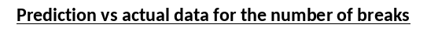
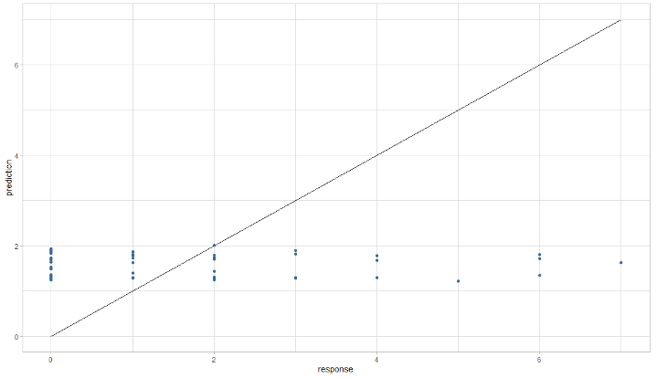
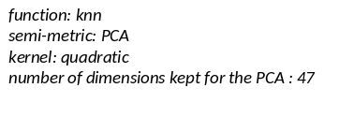
I. Data Quality C. Functional data analysis
IDEA : use the amplitude curves as explanatory variables (1 point = 1 variable) to predict the quantitative response variables (number of breaks and bites)
Different methods to analyse the data, and different parameters to fix
BUT : A response variable doesn’t implicate a special move of the curve at a special point
Notes:
Analyse fonctionnelle :
Idée : Courbes d’amplitude sont considéré comme des fonctions, extraction d’une variable réponse quanti à partir d’une courbe
WHAT : results for one of the methods in predicting number of breaks :
not working, model predicts between 1 and 2 no matter what the actual number of breaks is
Same kind of results for all the methods and parameters
Problème : Très mauvaise prédiction : une variable réponse n’implique pas une forme de courbe

Slide 26
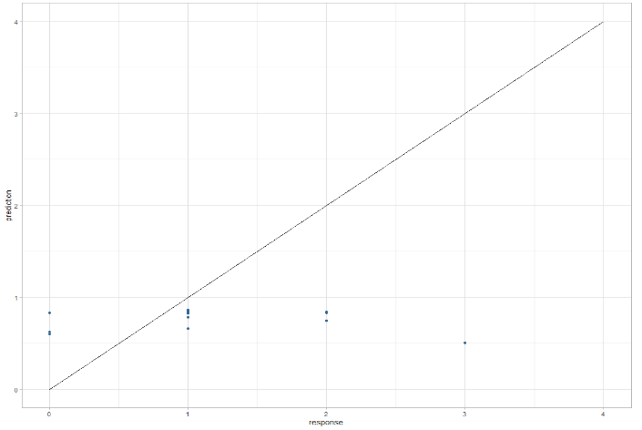
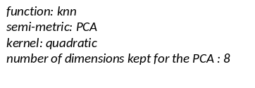
II. Counting events B. Labelling
IDEA : use the amplitude curves as explanatory variables (1 point = 1 variable) to predict the quantitative response variables (number of breaks and bites)
Different methods to analyse the data, and different parameters to fix
BUT : A response variable doesn’t implicate a special move of the curve at a special point
Notes:
Labelisation faible ou forte ?
Test : Est-ce que une labellisation faible (moins couteuse) suffit ?
Résultats de l’analyse fonctionnelle
Conclusion : labélisation forte

Slide 27
II. Counting events C. Break detection methodology
Predicted as Background noise
Contentious prediction
Predicted as break
= Frame described by features
Notes:
Machine Learning
Création du jeu d’entrainement
Performance du modèle
Nos données ont été labellisées de telle sorte que on a les zones des enregistrement où un croc se produit.

Slide 28
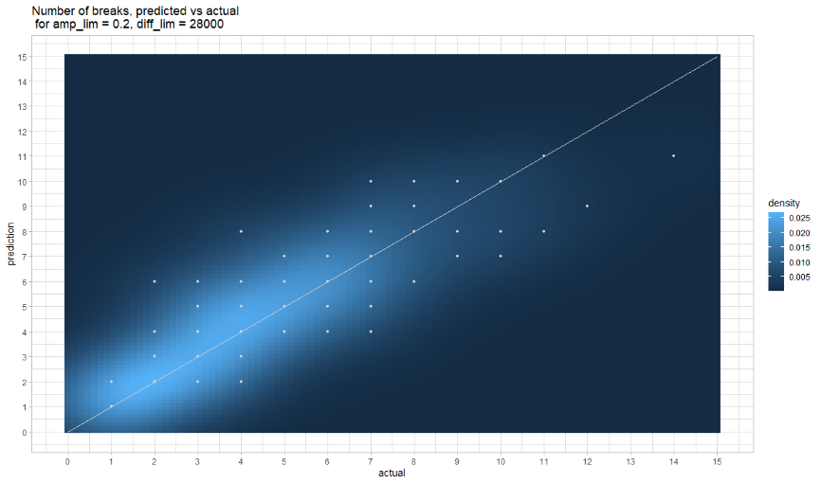
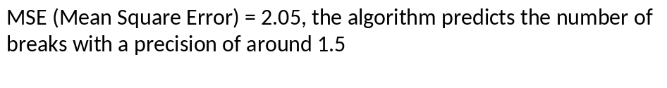
II. Counting events C. Break detection methodology – manual method
Problem : can’t predict correctly recordings without any break

Slide 29
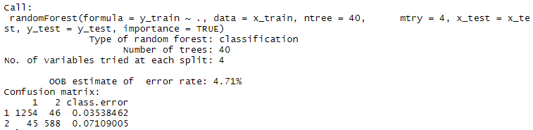
II. Counting events C. Break detection methodology - application of the random forest model

Slide 30
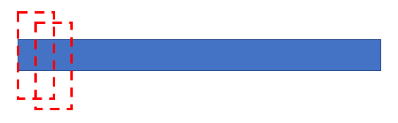
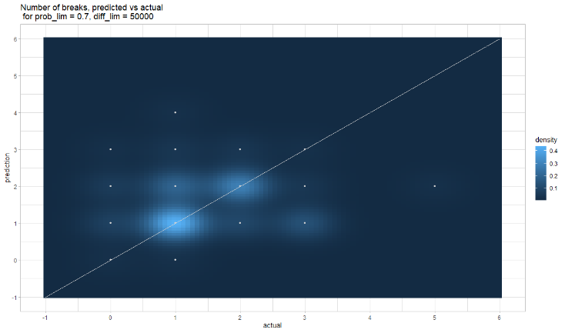
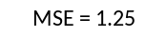
II. Counting events C. Break detection methodology - application of the random forest model
Going through the entire sample through frames, and using the random forest model to predict the probability for the fram of being an event or not
Then finding an optimal probability limit (probability of being an event) and distance between 2 peaks to count the total number of peaks

Slide 31
